Slide 1
Conversation class
Christopher bAUMAN

Slide 2
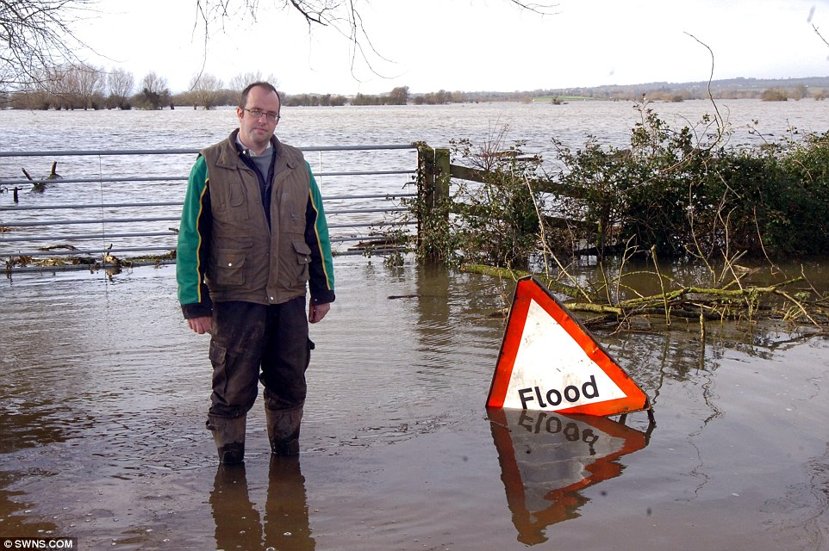
Education Infographic
Youtube
Struggle
Risk
Music lyrics

